Slide 1

Group - 14
Human Activity Recognition
Rohan Bait 21204008
Pratham Pise 20104069
Pratik Pandit 21204009
Project Guide
Ms. Mandar Ganjapurkar

Slide 2
Contents
Introduction
Objectives
Scope
Literature Survey
Proposed System
Algorithm Used
Project Outcomes
Block Diagram
Use Case/DFD
Technology Stack
Suggestions in Review-1
Result and Discussion
Conclusion and Future Scope
References

Slide 3
1. Introduction
Human activity recognition (HAR) is the process of automatically identifying and classifying human activities from sensor such as video data.
The HAR is to create systems that can accurately recognize activities such as walking, running, sitting, standing, and other activities of daily living.
The ultimate goal of HAR is to accurately recognize activities in various contexts and improve quality of life for individuals in different fields.

Slide 4
Problem Identified : identifying a physical activity carried out by an individual dependent on a trace of movement within a certain environment.
The challenge arises as there is no explicit approach to deduce human actions from sensor information in a general manner
Solution Proposed : characterization of human actions through the automated analysis of video data and is integral in the development of smart computer vision systems.

Slide 5
2. Objectives
Human activity recognition (HAR) aims to classify a person's actions from a series of measurements captured by sensors.
The primary goal of HAR is to create a system that can automatically recognize and classify activities such as walking, running, sitting, standing etc.
In general, the objective of HAR is to use machine learning and other AI techniques to automatically recognize and classify human activities, with the goal of improving efficiency, safety, and quality of life in various contexts.

Slide 6
3. Scope
HAR is a rapidly growing area of research, and its scope is expanding with advances in technology and new applications.
It can be useful for people to learn yoga movements at home easily.
It can also help to get a correct form of a certain yoga pose as it will track the movements of the person and once the pose is perfect it will inform.
As u can learn yoga poses from home it will definitely save time and also avoid travelling to yoga centres.

Slide 7
4. Literature Survey
Sr.no | Title | Author(s) | Year | Algorithms | Limitations | Result
1 | A Deep Learning Framework for Human Pose Estimation in Gym Environments | Srinivasan, D. | 2020 | Convolutional Pose Machines (CPMs) | Only tested on single-person scenarios, limited to indoor environments with static cameras | Achieved state-of-the-art results on single-person pose estimation benchmarks
2 | Pose2Pose: Pose Estimation for Action Transfer in the Gym | M. Pfeiffer, A. Dornbush, R. Berlich | 2019 | RetinaNet and Mask R-CNN | Limited to certain actions and environments, requires labeled action data | Improved the accuracy of action transfer from a source video to a target video in gym environments
3 | 3D Human Pose Estimation in the Wild by Adversarial Learning | S. Liu, L. Qi, H. Qin, J. Shi | 2021 | Adversarial learning approach | Limited by the quality of input images, may not generalize well to different camera viewpoints | Achieved state-of-the-art results on several challenging 3D pose estimation benchmarks

Slide 8
5. Proposed System
A proposed system for human activity recognition (HAR) typically consists of several components, including data acquisition, preprocessing, feature extraction, and classification.
Here is a general overview of the components of a proposed HAR system:
Data Acquisition
Preprocessing
Feature Extraction
Classification

Slide 9
6. Algorithm Used
1) Posenet -
The PoseNet model used in Gym Pose Estimation is trained on a large dataset of images and videos of people in various poses and positions.
During training, the model learns to recognize the patterns and relationships between the key body joints,which allows it to estimate the pose of a person in an image or video.
To use PoseNet for pose estimation in Gym, the model is first initialized with pre-trained poses.

Slide 10
7. Algorithm Used
2) TensorFlow -
The TensorFlow model works by taking an input image or video frame and processing it through a series of convolutional layers.
These layers are designed to extract relevant features from the image, such as the position of key body joints and other landmarks.
The output of the convolutional layers is then passed through a series of fully connected layers, which are designed to map the input features to a set of 3D joint coordinates that represent the estimated pose of a person in the image or video.

Slide 11
8. Outcome of Project
The outcomes of human activity recognition (HAR) can be beneficial in several different ways, depending on the application and context in which it is used.
Here are some of the potential outcomes of HAR: Since we used Human Activity Recognition in heal an awareness i.e the Yoga.
Health and Wellness: HAR can be used to monitor physical activity and detect changes in behavior, which can provide insights into an individual's health and wellness. This information can be used to develop personalized fitness plans, track progress, and prevent health problems.

Slide 12
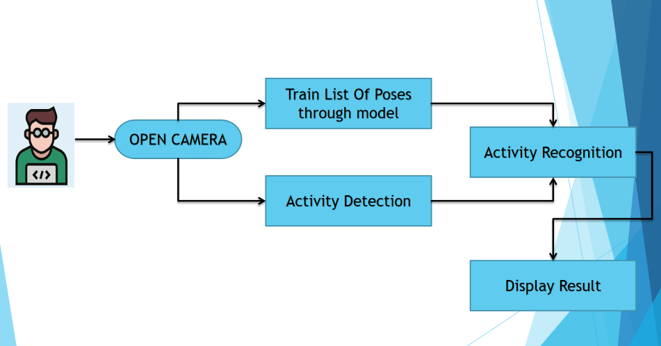
9. Block Diagram

Slide 13
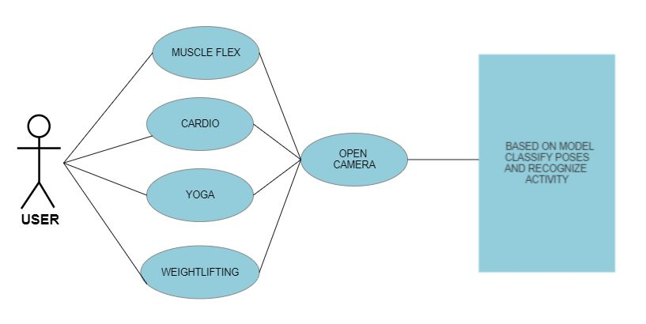
10. Use Case/Diagram

Slide 14





11. Technology Stack
Frontend:
Html,Css,Javascript &
Bootstrap
Backend:
Python
Tools:
VS Code (Visual Studio Code)

Slide 15
12. Suggestions in Review 1
To show pose accuracy in percentage bar format

Slide 16
13. Result and Discussion
The result of a human pose estimation project is a model that can detect and accurately estimate the human body pose from an image or video.
This model is trained using large datasets of annotated images and videos, which enable it to learn to recognize the key points and joints of the human body and to infer the relative position and orientation of different body parts.

Slide 17
14. Conclusion & Future Scope
Augmented Reality: Human pose estimation could be used in augmented reality applications to track the movements of a person's body and animate virtual characters accordingly, creating a more immersive experience.
Sports: In sports, human pose estimation could be used to analyze and improve athletic performance by tracking the movements of athletes during training and competitions.
Healthcare: In healthcare, human pose estimation could be used to monitor patients' movements and track their progress during physical therapy and rehabilitation.
Gaming: Human pose estimation could be used in gaming to create more interactive experiences that respond to the player's movements and gestures.

Slide 18
15. References
[1] Srinivasan, D. (2019). Deep human pose estimation: A Deep Learning Framework for Human Pose Estimation in Gym Environments.
[2]M. Pfeiffer, A. Dornbush, R. Berlich introduced a Pose2Pose: Pose Estimation for Action Transfer in the Gym.
[3] Wei, S. E., V., Kanade, T., & Sheikh, Y. (2019). DeepPose: Human Pose Estimation via Deep Neural Networks".
[4] N.Robertson and Issac Reid proposed a general method for human activity recognition in video using Computer Vision and Image Understanding.
[5] ZhuQ-Chen proposed how Supervised Deep Learning Method for Human Activity Recognition.

Slide 19
Thank You...!!

